Slide 1
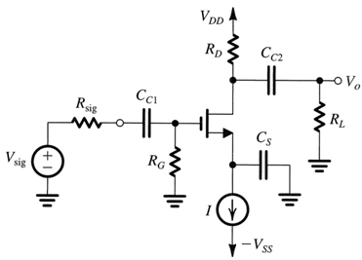
Quiz 4.1
Deadline: April 10, 2020
a) Fig. 1 shows the Mosfet circuit with R_{D} = R_{L} = 10 kΩ, R_{sig} = 50 kΩ, C_{C1} = 2.7nF and g_{m} = 1 mA/V.
Find C_{s} to obtain cutoff frequency f_{L} = 200Hz.
If the break frequencies due to C_{C1} and C_{C2} are (the same) 20Hz, find R_{G} and C_{C2}.
Find the voltage gain v_{o}/v_{sig} when all capacitors are considered as short-circuit.
Fig. 1
b) Fig. 2 shows the BJT circuit with R_{C} = R_{L} = 5 kΩ, R_{sig} = 2 kΩ, C_{E} = 22μF, R_{B} = 82kΩ, I_{c} = 1mA and β = 100.
If we select C_{E} such that is, say, 80% of ω_{L} = 2πfL, Find f_{L}.
If each of the other capacitors to contribute 10% to the value of ω_{L}, find C_{C1} and C_{C2}.
Find the voltage gain v_{o}/v_{sig} when all capacitors are considered as short-circuit.
Fig. 2

